Slide 1



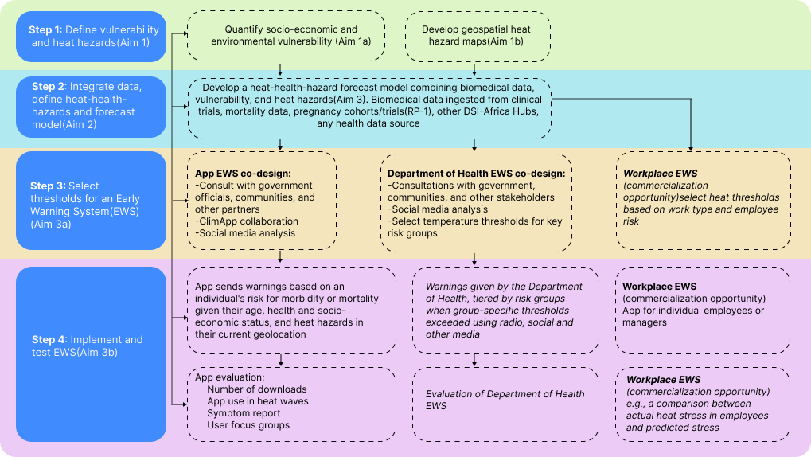
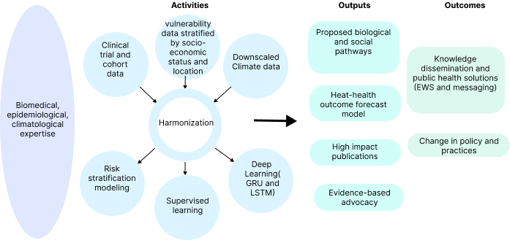
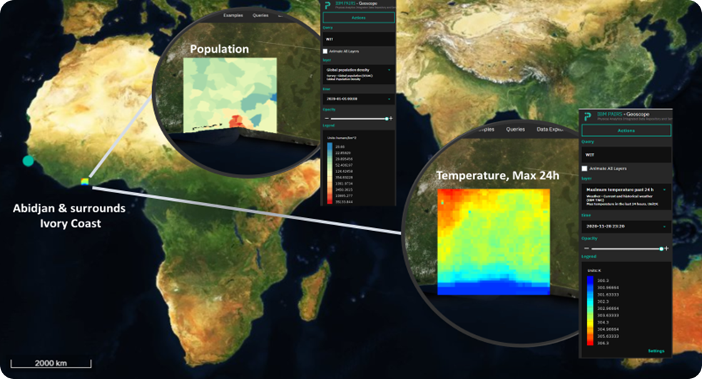







Innovative machine learning and multi-source data analysis toward the development of an urban heat-health Early Warning System in two African cities
A protocol of a multi-source secondary data analysis
Authors: Chris Jack^{1*}, Craig Parker^{2*}, Yao Etienne Kouakou³, Bonnie Joubert⁴, Kimberly McAllister⁴, Maliha Ilias⁵, Matthew Chersich², Gloria Maimela² Sibusisiwe Makhanya⁶, Stanley Luchters⁷, Etienne Vos⁶ Kristie Ebi⁸, Gueladio Cisse³ on behalf of the HE²AT Center *Equal first authors
Background
Methods and analysis
Across African cities, increasing temperatures, driven by global anthropogenic emissions, have coincided with rapid urban growth.
Temperature impacts the severity and distribution of health outcomes, but so do location, topography, society, and the environment.
Understanding this complexity ensures that solutions to the climate crisis consider urban areas' spatial and demographic characteristics. This poster describes the HE²AT Center's second research project.
The study is set in Abidjan, Ivory Coast, and Johannesburg, South Africa.
Data acquisition and pre-processing of data provide a foundation for subsequent steps in the study.
We will apply existing image processing techniques, particularly dimensionality reduction, to satellite images to further classify street density and layouts and generate urban typology maps.
We will combine data from recently developed high-resolution climate models with available meteorological station observations such as community observations, temperature variations with altitude, and land surface maps to create high-resolution vulnerability-hazard maps.
Following the creation of vulnerability-hazard maps, we will superimpose information on health outcomes from various sources.
Traditional statistical, machine learning methods and deep learning will be compared and used to optimize and develop models of heat-health outcomes.
Early Warning System based on the heat-health outcome forecast model, including a digital app.
Research plan
Aims
To create an index of African cities’ intra-urban socio-economic and environmental vulnerability.
To construct a spatially and demographically explicit heat-health outcome model that allows researchers to predict the likelihood of adverse health outcomes days or weeks prior to extreme weather events.
To develop an Early Warning System based on the heat-health outcome forecast model.
.
Methodology to create a spatially and demographically stratified heat-health outcome forecast model
Optimizing Machine learning and Deep learning model accuracy
We will evaluate the efficacy and accuracy of recurrent neural networks (RNNs), long short-term memories (LSTMs), and gated recurrent units (GRUs) in comparison to other machine learning techniques, such as the Multi-Layer Perceptron (MLP), Bayesian Neural Network (BNN), Radial Basis Functions (RBF), K-Nearest Neighbor regression (KNN), and Gaussian Processes (GRU). These measures are being taken to build the best possible model for predicting the health effects of extreme heat.
Next steps
Data acquisition will be the dominant focus over the upcoming months, with clinical and cohort data being requested from PIs and consortia across Johannesburg and Abidjan.
As data becomes available, we will focus on data pre-processing, developing code-book standards, and ongoing harmonization.
Continue establishing Dev-Ops and ML-Ops best practices to deliver reproducible datasets and models.
Vulnerability and heat hazard mapping in Abidjan, Côte d’Ivoire
Author Affiliations
1. Climate System Analysis Group, the University of Cape Town, Cape Town, South Africa
2. Wits Reproductive Health and HIV Institute (Wits RHI), University of the Witwatersrand, Johannesburg, South Africa
3. University Peleforo Gon Coulibaly, Korhogo, Côte d’Ivoire
4. National Institute of Environmental Health Sciences, Durham, NC, USA
5. National Heart, Lung, and Blood Institute, Bethesda, MD, USA
6. IBM Research Africa, Johannesburg, South Africa
7. Centre for Sexual Health and HIV & AIDS Research, Harare, Zimbabwe
8. University of Washington, Seattle, WA, USA
Acknowledgment: The research was supported by the Fogarty International Center and National Institute of Environmental Health Sciences (NIEHS), and OD/Office of Strategic Coordination (OSC) of the National Institutes of Health under Award Number U54TW012083. The content is solely the responsibility of the authors and does not necessarily represent the official views of the National Institutes of Health.
Corresponding Author:
Dr. Chris Jack Email: cjack@csag.uct.ac.za
Website: https://heatcenter.wrhi.ac.za

